Slide 1

Dr.A.ANBARASI
Dept of physics
PAC,CUDDALORE
Photo transistors

Slide 2
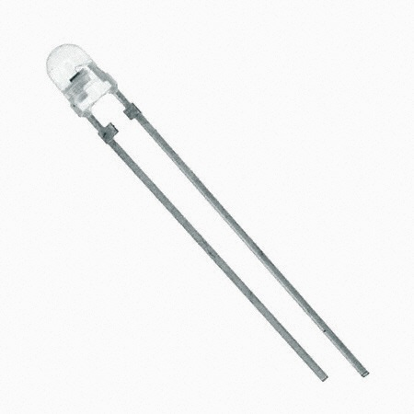
Photo transistor

Slide 3
Characteristics of phototransistors
Spectral Response. The output of a phototransistor is dependent upon the wavelength of incident light. ...
Sensitivity. ...
Linearity. ...
Collector-Emitter Saturation Voltage - V. ...
Dark Current - (I_{D}) ...
Breakdown Voltages - (V_{BR}) ...
Speed of Response. ...
Selecting a Photodetector.

Slide 4
definition
A Phototransistor is a device that has the ability to detect the level of the incident radiation and accordingly change the flow of electric current between emitter and collector terminal.
It is a 3-layer semiconductor device that consists of a light sensitive base region.
It is basically a transistor whose action depends on the application of light. Hence named phototransistor.

Slide 5
Construction of phototransistor
As we have already discussed that a phototransistor is nothing but a normal transistor whose action depends on the incident radiation falling at its base.
At the time of constructing the phototransistor, the base and collector region is provided with a larger area in comparison to a normal BJT.

Slide 6
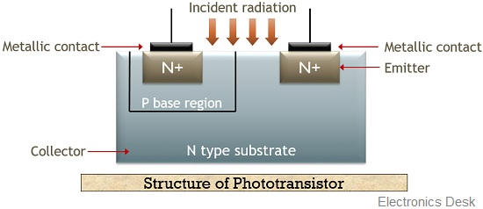

Slide 7
Here, as we can see that the light is majorly allowed to incident at the base collector junction. Initially, phototransistors were fabricated from silicon or germanium as their basic material that resultantly provides homojunction structure.
However, in recent times, these are constructed using materials likes gallium or arsenide. Thereby, providing a heterojunction structure.
This is so because these structures exhibit large conversion efficiency. This implies they are more capable of changing light energy into electrical energy as compared to homojunction transistors.
Phototransistors are mainly enclosed in a metallic case that consists of the lens at the top in order to gather the incident radiation.

Slide 8
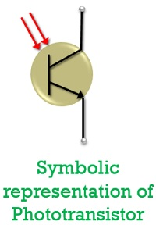

Slide 9
Here, the symbolic representation is almost similar to a normal BJT but the only variation is the presence of two inward arrows at the base region that shows the incident of light radiation.

Slide 10
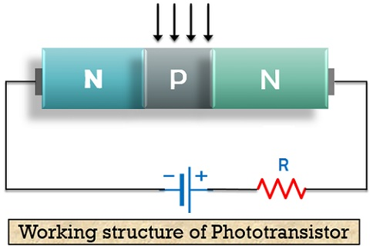

Slide 11
Working of Phototransistor
The operation of a phototransistor depends on the intensity of radiation falling at its base region. Its working is almost similar to a normal transistor, however;
the variation lies in the input current that drives the circuit. And in the case of a phototransistor, the incident light generates driving current.

Slide 12
In the circuit arrangement, we can clearly see that the base region is kept unconnected with the external supply voltage and is used as the region for radiation incidence.
Only the collector region is connected to the positive side of the supply provided along with emitter which is connected to the negative side.
However, the output is taken at the emitter terminal of the transistor.

Slide 13
When no any light is allowed to incident at the base region of the transistor, the due to temperature variation, movement of minority carriers across the junction generates a very small current through the transistor which is reverse saturation current basically termed as dark current.
Here, the base current I_{B} is majorly 0. Here, in this case, the output current will be less as compared to supply provided.
But, when a certain amount of light energy is allowed to fall at the base of the transistor, then electron and hole pair gets generated.
The applied electric field causes the electrons to move into the emitter region, thereby generating large electric current.

Slide 14
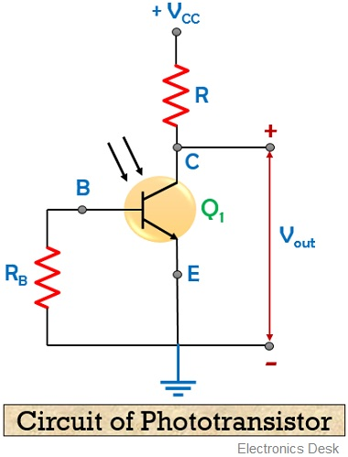

Slide 15
As the intensity of the light falling at the base region is increased, the current through the device also increases.
Here, the generated photocurrent majorly depends on the illumination provided to the base.

Slide 16
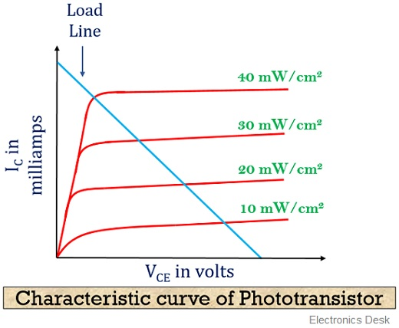

Slide 17
Here x-axis represents the voltage applied at the collector-emitter terminal of the transistor and the y-axis represents the collector current that flows through the device in mill amperes.
As all the curves in the above figure are clearly indicating that current increases with the intensity of the radiation that falls at the base region.

Slide 18
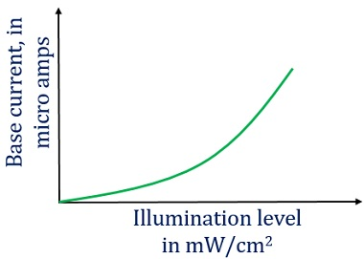

Slide 19
Advantages of Phototransistor
These are a highly sensitive optoelectronic device.
It is less complex and inexpensive.
Phototransistors provides a large output current with high gain.
Disadvantages of Phototransistor
It provides a low-frequency response.
In the case when a small amount of illumination is provided, the circuit is not able to detect it effectively.
Electric surges are more severe in phototransistors rather than a photodiode.
Phototransistors gets affected by the variation in electromagnetic energy.

Slide 20
Applications of phototransistor
The applications of phototransistors are as follows:
In light controlling and detection: As phototransistors are a very sensitive light detector. Thus these are widely used in light detection and controlling applications.
In an indication of level and relays: The device finds its uses in indicating the level of some systems because of their light sensing ability.
In counting systems: Phototransistors can be effectively utilized in counting systems. As it has tremendous ability to combinely operate as photodiode and transistors. Thus, failure of supply will not cause much adverse effects on the system.
In punch card readers: Phototransistors widely finds its applications in punch card reading.

Slide 21
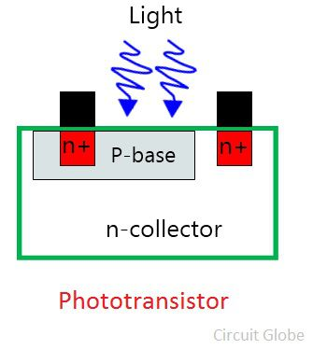

Slide 22
The phototransistor is made up of semiconductor material. When the light was striking on the material, the free electrons/holes of the semiconductor material causes the current which flows in the base region.
The base of the phototransistor would only be used for biasing the transistor.

Slide 23
